Slide 1
Computer Science
Logical Inferences
Samuel Lukas

Slide 2
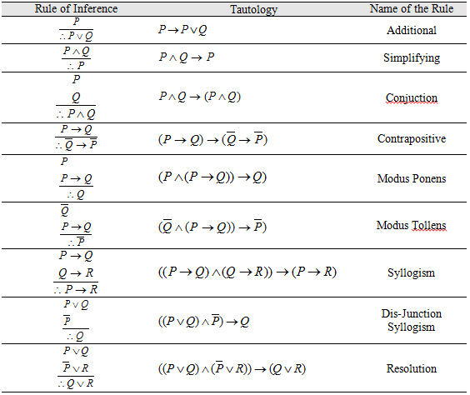
Basic Inference Rules

Slide 3
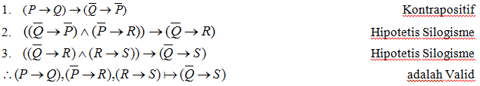
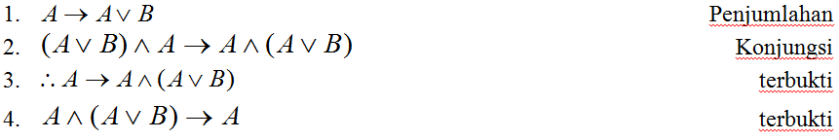
Example 01

Slide 4
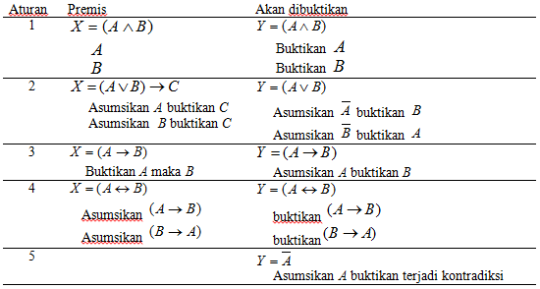

Basic Proving Steps
$$X conclude Y$$

Slide 5

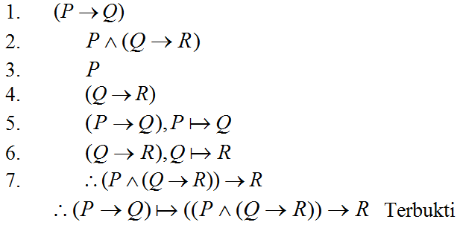
Example 02

Slide 6
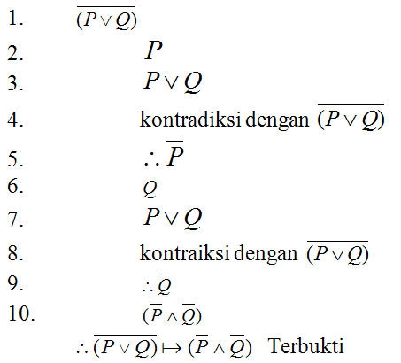
Example 03

Slide 7
Resolution
Prove !
Concept :

Slide 8
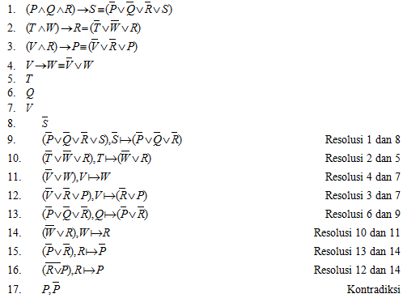
Example 04

Slide 9
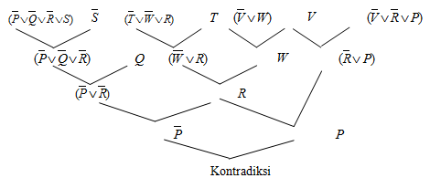
Other alternative using tree

